Slide 1

Alternative Cards
October 2011
Strictly Private and Confidential

Slide 2

Alternative Cards
Agenda
Experienced AOPC
Industry Challenges and Trends
Growth Opportunities
Review Citi Products
Ghost Cards
Virtual Cards
Buyer Initiated Payment Card
Notes:
Some products are not currently on the Texas contract, but both Texas and Citi are open to including if there is demand.

Slide 3
1. Industry Challenges and Trends
Alternative Cards
3

Slide 4
Alternative Cards
Market Environment: The Current Challenge
Experienced AOPC
Customers face common challenges in managing payables effectively
Entities are under pressure to reduce expenses, increase efficiency and optimize budgets
Entities and their suppliers may be affected by credit constraints and their access to capital and liquidity
Entities are moving away from a silo approach to managing the procurement to payment cycle and budget optimization initiatives together
Entities are moving towards an electronic solution and automation of the supply chain
Accounts Payable and Procurement focus on the tangible tasks of managing the supply chain
Manage Supplier Relationships
Operating Efficiencies – Smooth operations equal happy internal partners
Control – Understand and manage processes tightly
Compliance – Ensuring that the process follows the rules
4

Slide 5
Alternative Cards
Market Environment: The Goal
Experienced AOPC
With improved efficiencies, shortened cycle time, and improvements in budget optimization, Entities can:
Unlock cost savings and increase efficiency:
Automate payments
Electronify accounts payable and any manual/paper-based processes
Shorten invoice cycle time to open up Budget Optimization opportunities
Optimize budgets, cash management, and days payable outstanding:
Early visibility into cash and payables requirements
Access early payment discount opportunities
Purchasing Card rebates and payment terms
Strengthen compliance and control:
Put electronic controls in place (invoice matching, contract compliance, etc.)

Slide 6

Alternative Cards
The Market is Moving to Electronic Payables
Experienced AOPC
Payment Automation
Wholesale Non-Cash Payments: 2006
Wholesale Non-Cash Payments: 2011
Invoice Automation
70%
60%
50%
40%
Percent of Invoices by Delivery Method
30%
20%
Electronic Invoices
10%
Paper Invoices
0%
* This chart only takes into account B2B invoices traded within the US
2006
2007
2008
2009
2011
2011
2012
PayStream and Aberdeen
6
Notes:
The market landscape for Accounts Payable is clearly evolving. Best in class companies are aggressively migrating their paper checks to electronic forms of payment.
In addition to payments, clients are also automating their invoice process – moving from paper based invoicing to electronic invoice processing and workflow automation. In fact, Aberdeen predicts that electronic invoices will surpass paper in 2011.
Fact: The current US B2B payments opportunity amounts to $36 trillion per year

Slide 7
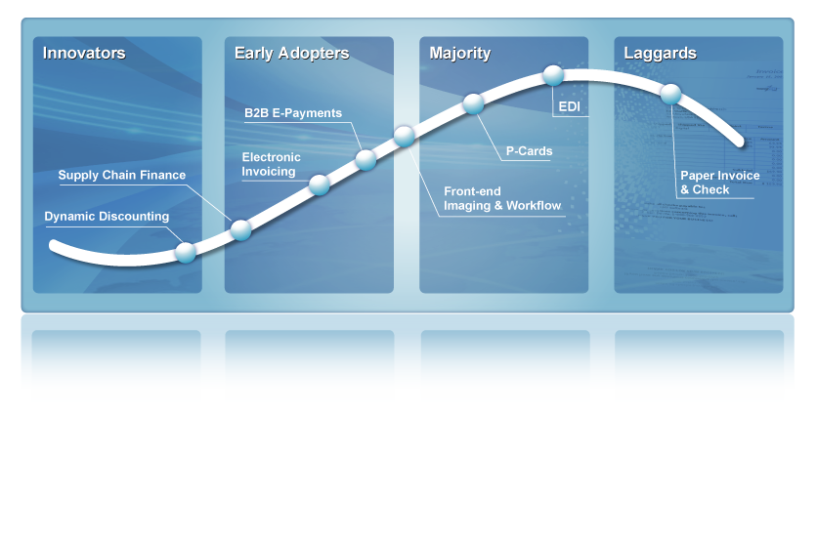
Alternative Cards
Stages of Automation Vary
Experienced AOPC
Introduction
Growth
Maturity
Decline
1
2
3
4
PayStream Advisors
7

Slide 8


Alternative Cards
Summarizing Our Clients’ Needs
Experienced AOPC
Reduce processing costs
Eliminate paper purchase orders, invoices, and checks
Speed payment and invoice reconciliation
Improved timing, tracking, and security
Enhanced tracking and security of payments
Efficiency
Control
Visibility
Budget
Instant View of Payables
Manage cash needs upon invoice arrival
Provide visibility to Suppliers
Reduce risk exposure
Budget Drivers
Access supplier discounts
Increase card rebates
Manage Days Paid Outstanding (DPO) – limit PPI
8

Slide 9
Benefits of Program Expansion
Alternative Cards
®
9

Slide 10

Alternative Cards
Value Proposition for Proposing Alternatives
All Audiences
TIPRA requirements
3% withholding
1099 reporting
IRS changes
Improve efficiency
Reduce payment processing costs
Enhanced spend reporting
Greater control options
Potential for improved and preferred merchant relationships
Increase refunds
®

Slide 11

Alternative Cards
Consider Scenarios for Expanding the Card Program
All Audiences
Move check payments to card for consolidated spend tracking
Optimization
Program expansion opportunities
Merchant cash flow issues
Economic impact of check versus card payment
Enhance Strategic Sourcing
Create or improve current plan
Socioeconomic targeted spend
®
Notes:
What goes on in your organization that has prompted the query, I wish we could use the card to……..fill in the blank.
The intent of this session is to stimulate the proverbial outside the box thinking.
Some food for thought is using an optimization project to identify where and how the money is being spent at your organization that isn’t already on the card. You will be surprised how much of the budget is not on the card.
Identifying merchants paid by check that accept the card is the first step. Then dissecting that spend to determine the average transaction amount will give you insight towards large ticket transaction volumes. Optimization can open several doors to determining how to expand your program. We know that increasing card spend will translate to increased refunds.
Your merchants may have expressed concern that it takes 45-60 days to be paid. This hurts their cash flow and ability to turn their inventory more quickly. Moving them to card payments should be the easy choice. This can also be another by product of the optimization analysis.
When you have your spending trend data, you can determine which merchants are candidates for strategic sourcing discount discussions. It is not easy to combine the spend through AP and on the cards to get the big picture with your merchant spend. Driving more spend to the card helps to gather that information. Finding ways to put more large ticket transactions on the cards will facilitate this information consolidation.
Property purchasing can come in all shapes, sizes and dollar amounts. Reviewing your current purchasing patterns with certain products may lead you to a strategic sourcing opportunity or consolidated, centralized purchasing plan. This may lead to large dollar per transaction buying.
Minority, Women owned, Veteran owned business should be an important part of your purchasing process. Some agencies have some required targets to meet with their annual spending. Again it can be an issue of driving the transactions through the card to be able to pull this data and report it. Finding ways to put these over $3000 transactions on the card helps the business and your program.

Slide 12
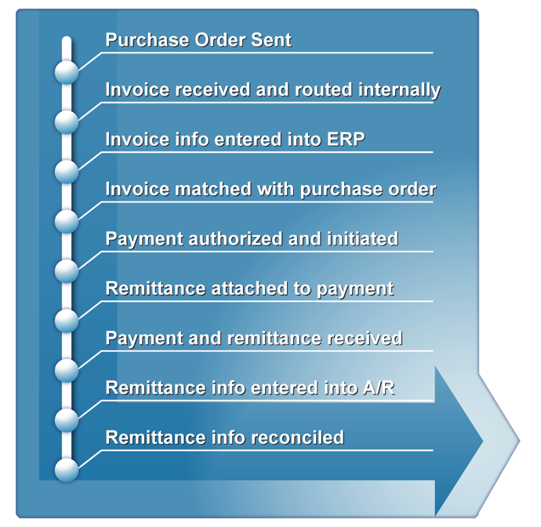
Alternative Cards
Citi Procure to Pay – Overview
Experienced AOPC
The collective set of accounts payable processes that begins with the issuance of a Purchase Order and ends with payment to the supplier:
The procure-to-pay cycle
Electronic
Paper-Based
10
Days
30-60
Days
12

Slide 13

Alternative Cards
Program Expansion
All Audiences
Identify payment needs that may move beyond standard card use
Demand for solutions
Buyers asking for alternatives
Merchant complaints
Accounts Payable backlog
Does entity mission include efficient growth?
Non-card payments now
Working with accounts payable
Meet all procurement needs?
®
Notes:
How do you know if you need an alternative payment product to the standard purchasing card?
You may have had conversations with your buyers where they have complained that they had to use the old invoice process instead of card payments with certain types of purchases.
Additionally, you may have had vendors comment on the preference to be paid by card.
Look for evidence that Accounts Payable has somehow developed a backlog for getting payments out.
Are there aspects of your organization mission that might drive the need for alternatives to the standard card.
Look at what the non-card payments are, you will have to find a way to have AP work with you
This might help identify areas where the procurement process is inefficient?
The AP file for optimization will be helpful for multiple opportunity idenification.

Slide 14

Alternative Cards
Explore Alternative Payment Options
All Audiences
High-volume merchants
Ghost Card
Department Card
Virtual Card
Review contracts and payments
Special procurement accommodations
Ghost Card
Department Card
Declining Balance Card
Virtual Card
®

Slide 15

Alternative Cards
Discuss Opportunities for Large Dollar Transactions
All Audiences
Grants and projects
Support purchase control requirements
Department Cards
Declining Balance Cards
Virtual Card
Meetings and Conferences
Spend controls – card limits and MCC
Spend tracking requirements
Meeting Card
®
Notes:
If you are able to use the card as the primary payment mechanism, this provides an excellent tracking system to support your reporting requirements in the grant process.
Projects may include participants that need to execute procurements but they don’t have the warrants for the higher dollar transactions. Similar actions may be required as described with the contracts topic. Projects may involve a broader group of merchants so expansion of entitlements will need to be accompanied with appropriate internal controls.
Virtual card is designed for non point of sale transactions.
Use the online system to create a card account with expiration date to enable transaction authorization.
That account number can be single use and no longer able to transact, or you can designate how many transactions can occur.
Can also dictate the merchant it will be transacting with, the amount and during what time frame can a transaction occur.
The ability to have an account become deactivated after the designated use eliminates the concern over merchant card account retention and incorrect transaction processing.
This should help with internal controls requirements and is an excellent product for the high dollar transactions.
Some applications might be projects and contracts, temporary spend categories, could be useful with high volume shipping/courier service users.
Property purchases have specific requirements as stated in the OMB circular A-123. Tracking of the acquisition of the property along with the detail included could lead you to use an alternative product that ensures the detail is received. Virtual card or Buyer initiated may provide the needed detail data you must have to meet the reporting requirements.
Policies and Procedures attempt to provide standards for operations to include the internal controls. There are always exceptions that can be documented and accommodated in the organization. Referring back to the OMB Circular, one of the driving goals is to create efficiencies, cost reductions as long as you have the internal controls to mitigate any risk. What might work for one division may not for another.
The mission statement for your organization may lead to opportunities not immediately considered in your normal program management and operations.

Slide 16
2. Ghost and Declining Balance Cards
Alternative Cards
®
16

Slide 17
Alternative Cards
Ghost Cards – Supplier Initiated
Experienced AOPC
Features:
Non-card account for preferred supplier relationship
Account number held by vendor
A Seller Initiated Payment
Allows many employees to purchase without issuing multiple cards
Integrates with ERP systems or Electronic Purchasing Systems
Applications and Uses:
Central travel airline accounts
Purchases made via internet or intranet
Elimination of low value invoices (i.e. UPS, FedEx, etc.)
Notes:
Ghost cards are really a generic term for different purposes for card use. The one feature that is common is the card does not have a magstripe on the back and is not used at the point of sale.
Could be a department card or a vendor card used to execute payments.
Declining balance is very similar. This is a highly controlled account that can be made available with singular intent, or can be refreshed for repeat users.
Coaches card or sporting activities card might be an option.
Emergency cards. Social activity cards at schools to pay for the sundry items needed.

Slide 18
Alternative Cards
Declining Balance– Supplier Initiated
Experienced AOPC
Features:
Spend controls
Single event or refresh for repeated use
A Seller Initiated Payment
Improved cash flow – cycle billing
Transparency – full view of transactions using statements and reporting
Applications and Uses:
Restricted travel
Eliminate petty cash
Emergency, meetings, events
Notes:
Declining balance cards allow for greater controls in spending yet give the same benefits of regular cards.
Still have full dispute rights, no cash outlay, efficiency, eliminate checks/stop payments

Slide 19
3. Virtual Cards
Alternative Cards
19

Slide 20

Alternative Cards
Virtual Cards – Overview – Supplier Initiated
Experienced AOPC
Virtual Card Accounts (VCA) is an electronic global payment solution that offers unparalleled control and flexibility without the need to issue plastic cards
What is a Virtual Card Account (VCA)?
Non-plastic account number for purchases
The “real” billing account/card is never shared with merchants
Unique virtual card numbers (VCNs), linked to real card, are created for secure purchasing
Transparent to merchant at point-of-sale
Standard 16-digit account number, expiration date, 3-digit security code created for seamless transacting by the merchant
Virtual Card Numbers can be requested by authorized users or a system interface
Web interface, batch file, real-time XML API
The Banker Technology Awards – Citi’s Virtual Card Account wins 2010 innovation in Payments Technology Award
20

Slide 21




Alternative Cards
Virtual Cards – How it works – AP Automation Example
Experienced AOPC
VCN request with CDFs (PO #, Invoice #, GL code, etc.)
Entity ERP
Merchant
Pre-transaction
Post-transaction
Report
Reconcile
Allocate
Transaction data with CDFs
Reporting
Reconciliation
Allocation
Improved spend monitoring and compliance with capture of purchase description, employee ID, etc.
Increased spend insight and pattern analysis from additional client-provided transaction information
Automate matching of POs or Invoices with virtual card transactions by using the PO or Invoice # as a Client Defined Field (CDF )to serve as a unique key
Export Data file from Citi GDR
Easily allocate expenses by requiring accounting code information at the time of VCN creation
Use an automated process to map expenses to general ledgers based on the custom data fields
21

Slide 22
4. Buyer Initiated Payment Card
Alternative Cards
22

Slide 23
Alternative Cards
Buyer Initiated Payment Cards - BIPC
Experienced AOPC
BIPC automates end-to-end payment processing on a commercial card platform while increasing security, control, and efficiency
What is a Buyer Initiated Payment Card?
File-based payment process
Buyer initiates payment via file submission (modified EDI 820) to Citi & the Payment Gateway
Payments settle on a master purchase card account (s)
Payment is straight through to the vendor’s bank account
Payment Gateway
Central infrastructure where suppliers must securely register to receive straight through payment
Matches payment detail in Buyer’s file to registered vendors without the need for transmission of sensitive bank account details
Online portal which provides email remittance and houses payment status and details for use by Buyer or Vendor in reconciliation process
23

Slide 24
Alternative Cards
Buyer Initiated Payment Card
Experienced AOPC
Security
Efficiency
Card number(s) is never shared outside of Buyer organization
Reduce risk of wrongful use/fraud
Sensitive bank account details are never transmitted
Offers consistency across electronic payment processes
Similar to ACH processing
Streamlines payment processing directly from ERP
Provides rich remittance detail via email and download from online portal for Buyer or Vendor
Reduces payment processing and handling time
Check creation, cutting, mailing
Manual keying of card account number
Removes paper (and associated costs) from payment process
Control
Buyer initiates payment to Vendor at their discretion
Eliminates uncertainty of check clearing timeline
Eliminates uncertainty of vendor card payment initiation
24

Slide 25

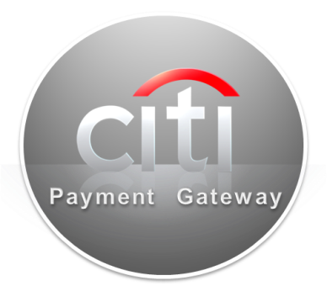

Alternative Cards
BIPC– Process Flow
Experienced AOPC
Purchase Order
1
Invoice
Supplier A
2
3
Bank
Buyer
Supplier B
4
Bank
5
5
Supplier C
Bank
Buyer sends purchase order to supplier and subsequently receives/approves invoice
Buyer sends transaction instruction file to Citi
Citi validates file, matches supplier data and sends to Boost for authorization and settlement
Vendor receives payment directly into its acquiring bank account
Buyer and vendor receive remittance detail
25

Slide 26
Alternative Cards
Buyer Initiated Payment Card– Best Practices
Experienced AOPC
Based on experience, we recommend and will help you implement the following steps to ensure a successful program
Organizational Alignment
Vendor Targeting and Contact Information
Campaign Configuration and Support
Announce implementation and directive for product use within organization
Obtain buy-in from Treasury, A/P, Shared Services, Procurement/Sourcing
Ensure objective is aligned: Budget Optimization gains and process efficiency
Include Payables Account/Gateway as default payment type when negotiating new contracts
Work with Citi and partners to target suppliers appropriately
Annual spend
Historical average transaction size data (> $10,000)
Current payment type (check)
Number of annual payments (between 5 – 20)
Review Current payment terms
Provide contact information and work with Citi and partners to navigate suppliers’ organization to enroll
Mandate enrollment to target suppliers
Provide incentive by way of expedited payment terms to target suppliers
Provide dedicated ongoing resource to work with Citi and partners to maintain and grow program
26

Slide 27
Alternative Cards
BIPC vs. Supplier Initiated
Experienced AOPC
Buyer Initiated
Supplier Initiated
Buyer initiates P-Card payment by routing charge/payment detail
Card number maintained in secure Electronic Payment Gateway database
File-based process mimics existing ACH processes in accounts payable and ERP systems
Buyer controls process
Timing of payment, amount, card/account number
Vendor impact
Eliminates need to manually process transactions at POS terminal and retain a card number
Supplier processes P-Card transaction by entering card details in POS/acquiring bank interface
Card / account number communicated to vendor with each transaction, or specific card maintained by vendor
Vendor controls process
Uses existing hardware/software/ process/reporting
Controls timing of transaction
Potential for vendor to modify timing/ amount, resulting in reconciliation issues
Supplier impact
Traditional card transaction posting, payment, allocation, and reconciliation (potentially manual)
27

Slide 28

Alternative Cards
Comparison of Non-Traditional Cards
Experienced AOPC
Traditional Ghost Cards
Card number used with traditional transaction and reconciliation processes
Citi Virtual Card Accounts
Dynamically generated single or multiple use virtual cards with robust controls
Buyer Initiated Payment Card
File-based, buyer-initiated, straight-through payments settled via card
Card/account number communicated to vendor with each transaction, or specific card maintained by vendor
Standard transaction process – limited ability to set transaction controls
Traditional card transaction posting, payment, allocation and reconciliation (potentially manual)
Enhanced controls versus traditional ghost card approaches
Ease of integration – real-time, batch file or web user interface
Capture strategic, one-off, and large ticket purchases within card program
Buyer-initiated and control of payments
Module of Citi’s P2P electronic payments platform
Consistent processing / integration
Capture recurring payments to core suppliers

Slide 29
Alternative Cards
Comparison of Non-Traditional Cards
Experienced AOPC
BIPC
Citi’s Extensive Product Range
Traditional Plastic P-card
Traditional Plastic Card Account with credit line. Ideal for low to medium value purchases needed to support business flexibility
Ghost Card
Card Account is held in trust by a key supplier, charged at buyer’s instructions
Ideal recurring for purchases and Catalog buy
Virtual Card Account (VCA)
Non-plastic Card Account setup for a specific amount and timeframe, with customized control fields for automatic reconciliation
Buyer Initiated Payment Card (BIPC)
File based solution to make payments by effectively “pushing” (straight-through processing) the transaction to the supplier. Perfect to pay for large strategic purchases without showing account info while still delivering remittance information to the merchant
High
Very High
Virtual Card
Transaction Size
Control
Ghost Pcard
Pcard
Low
High
Low
Spend per Supplier
High
29

Slide 30
Alternative Cards
Identifying Opportunities
Experienced AOPC
Use Area | Description | Examples
Reconciliation issues | Lack of reporting/spend level details for multiple purchases; manual or complex processes; vendor accuracy | Volume purchases, ad hoc purchases, de-centralized purchasing like office supplies, couriers, facilities maintenance
Compliance concerns | Need to enforce compliance with policies and purchase thresholds | High employee turnover, restricted commodities, large-ticket purchases (e.g. recruiting travel, software, etc.)
Risk of fraud or misuse | Nature of purchase -who is making purchase, vendor, amount -create greater concerns re control | Purchases from non-core suppliers, one-time purchases, purchases for satellite offices, contractors
High transaction volume | High volume transactions in certain businesses require significant efficiencies on card processing | Online ordering and bookings (e.g. travel) that support thousands of transactions daily
Inefficient manual processes | Faxed timesheets, handwritten signatures, paper checks | Temporary staffing
30

Slide 31
7. Final Thoughts
Alternative Cards
31

Slide 32
Alternative Cards
Final Thoughts
Experienced AOPC
Some questions you may want to think about …
Am I not able to pay supplier invoices via a card due to an approval process requirement?
Are there reconciliation issues currently with certain types of payments?
Does my organization have a large amount of one-off ad hoc spend that is paid via checks?
Am I spending a great deal of time with offline processes and manual reconciliation?
Would I like to put more controls on card usage and spend categories?
Would additional information help reconcile my accounts payables better?
Is there a spend category my organization could put on a non-traditional card product?

Slide 33

Alternative Cards
Experienced AOPC
33

Slide 34

© 2011 Citibank, N.A. All rights reserved. Citi and Citi and Arc Design are trademarks and service marks of Citigroup Inc. or its affiliates and are used and registered throughout the world.

Slide 35
声明：
所有的版权属于原有公司，文件均来自公开渠道
此文件仅供学习使用，任何人不得进行以此为商业目的的行为
如有疑问，请立即删除
学习世界五百强和咨询公司PPT课程请访问如下网站搜索：“司马懿”
百度传课：司马懿PPT学校
https://www.chuanke.com
网易学堂：司马懿PPT学校
https://study.163.com
知乎： 司马懿PPT学校
https://www.zhiu.com

